Slide 1
OnRoad BreakDown
KESHAV MEMORIAL INSTITUTE OF TECHNOLOGY
JNTU HYDERABAD
Under the Guidance
of
Dr. K.L.S.SIRISHA
Associate Professor.
By:
Gottam Manasa - 16BD1A054N
Koyatti Sravanthi - 16BD1A055J
Koyati Swetha - 16BD1A055K
KSVT Nagila Krishna Veni - 16BD1A055G

Slide 2
Abstract
While travelling if your vehicle suddenly breaks down it is difficult to find mechanics in the nearby locality.
Our application helps people to find mechanical assistance during such times.
Customers just have to login to his/her account and provide their location and with-in few seconds our application provides you with the Service Provider.
Our application makes the process of finding service providers based on the location and the services requested by the user.

Slide 3

Problems with Existing systems
There are websites where they provide the service provider's information to the user for contacting.
This is not user friendly, as the user needs to check with every service provider.
Service Provider will not be intimated about any requests.
It may not guarantee or assure help in some circumstances.

Slide 4
Proposed System
When a person is in need of a service provider. The user will have to mention his details, location and the services required by him.
Depending on the services and the location the web application will choose the most optimal service provider.
The service provider will be informed about the location and the service that has to be provided.
The user Information will be mailed to the Service Provider and Service Provider Information to the User.

Slide 5

SCOPE OF the project
This application connects both the users and the Service Providers
The web application filters the area and retrieves the best suitable service provider in that area.
It alerts the service provider through a mailing system and the user will be able to know the service provider details.
The application asks user to enter Pin-code when he requests for service.

Slide 6

Technologies used
Java 8
Java Servlets
MySQL 8.0
Javascript 1.8.5
HTML 5
CSS 3
Bootstrap 4
Apache Tomcat Server 9.0.27

Slide 7
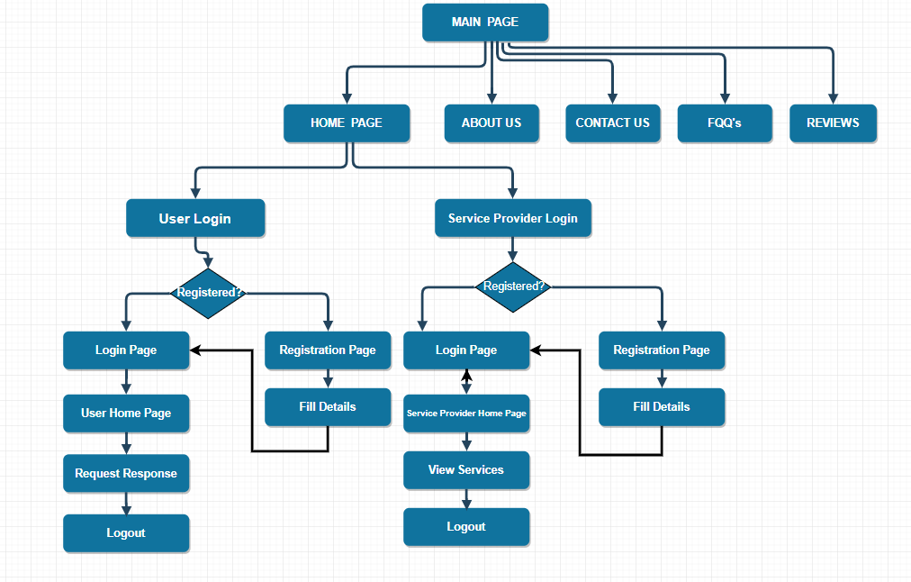
Project flow

Slide 8

IMPLEMENTATION DETAILS
Initially the web application consists of a web page which is dynamic in nature.
It takes information from the user in the HTML form where javascript is used for validation.
With the help of a servlets the information from the HTML page is retrieved and processed.
MySQL JDBC connector is used to connect to the database and do operations.
Mail API is used for sending mails to User and Service Provider.

Slide 9
conclusion
Breakdown of vehicle can be troublesome and can create a situation of panic any time. As such situations can't be avoided completely, measures can be taken.
One such attempt is this web application. It can be helpful to a great extent whenever such situation arise, by providing information without any research done by the user and thus avoiding a situation of panic.
The web application is helpful whenever a user is in search of data regarding service providers and can contact the service provider.
Normally when such a situation arises, the user will be searching the information of the various service providers in that particular area, but having applications like OnRoadBreakDown reduces the work of the user and avoids any possible confusion.

Slide 10
Future enhancement
Our application currently provides an interface between the user and the service provider.
It is capable of selecting a service provider for the user, displaying the services provided by the Service Provider, sending Mails to the Service Provider, User and Password Recovery.
In the future we would like to make the web application capable of taking the location of the user with the help of a GPS and provide the services.
We also intend to make communication between the user and the service provider stronger by enabling the SMS system.
We also intend to develop an android application with the GPS system for easier usage.

Slide 11
THANK YOU

